Slide 1
Object Detection
Using YOLO v3

Slide 2

Table Of Contents
Introduction
Objectives
Literature Review
YOLO Architecture
Implementation
Methodology
Results
Conclusion
Future Work

Slide 3
Introduction :
Artificial Intelligence
Computer Vision
Object Detection
The goal of object detection is to detect all instances of objects from one or several known classes, such as people, cars, or faces in an image.
Typically, only a small number of objects are present in the image, but there is a very large number of possible locations and scales at which they can occur and that need to somehow be explored.

Slide 4
Objectives :
Real – Time Object Detection :
To implement a high-speed and accurate object detection system suitable for real-time applications.
Automated Object Detection :
Detect and localize multiple objects in ages using YOLOv3's deep learning architecture.

Slide 5
Literature Review
1. DPM
2. CNN
Primarily designed to extract features from grid-like matrix datasets.
Process data in one direction from input to output without retaining information from previous inputs.
Good at detecting patterns and features in images
Requires large amounts of labeled data and struggle with sequential data since they lack memory.
Classification alone.
There’s a dog in this photo.
It represents an object as a collection of parts each with some deformability in position relative to others.
It will detect the parts of an object independently.
It allows parts to move slightly from their initial positions.
It is like building a Lego model where each piece can shift a bit even if not perfectly aligned, you still recognize the whole structure.

Slide 6
Literature Review
3. R - CNN
4. YOLO
Classification and Detection.
Finds(Proposes Regions) and then classify.
Multiple objects with labels
Complex
Let me first generate 2000 regions that might contain something. Then I’ll check each one with a CNN and a classifier.
Classification and Detection.
Single Neural Network : Passes everything at once. Therefore, directly classifies into the class.
Fast and simple.
Let me divide the image into a grid and, for each cell, predict what objects are there and where.

Slide 7
YOLO Architecture
Released on a website maintained by Joseph Redmon.
Instead of classifying parts of an image and then predicting bounding boxes separately, we:
Divide the image into a grid.
For each grid cell, the model predicts bounding box coordinates (x, y, width, height) directly.
Along with coordinates, it also predicts:
Objectness score (probability that an object is present in that box).
Class probabilities for different object categories.
This is done all at once, using a single CNN.

Slide 8
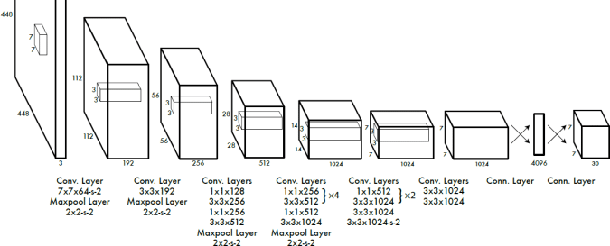
YOLO Architecture
A series of convolutional and max-pooling layers extract spatial features.
24 convolutional layers
Followed by 2 fully connected layers

Slide 9
Implementation:
Residual Boxes
Bounding Box Regression
Intersection Over Union
Non-Max Suppression.

Slide 10
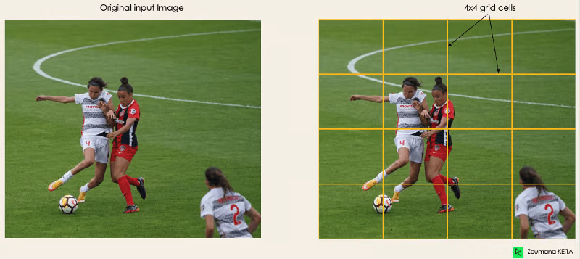
Methodology
1. Residual Blocks
Divide the image into a grid

Slide 11
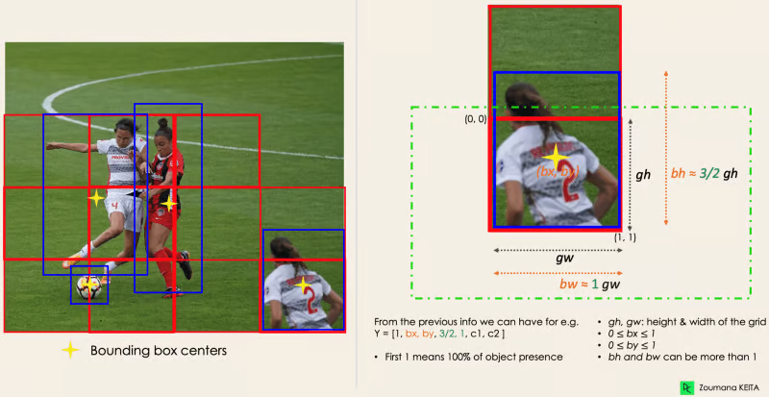
2. Bounding Box Regression
Finding the target output values using the following formula :
Y = [pc , bx, by, bh, bw, c1, c2]

Slide 12
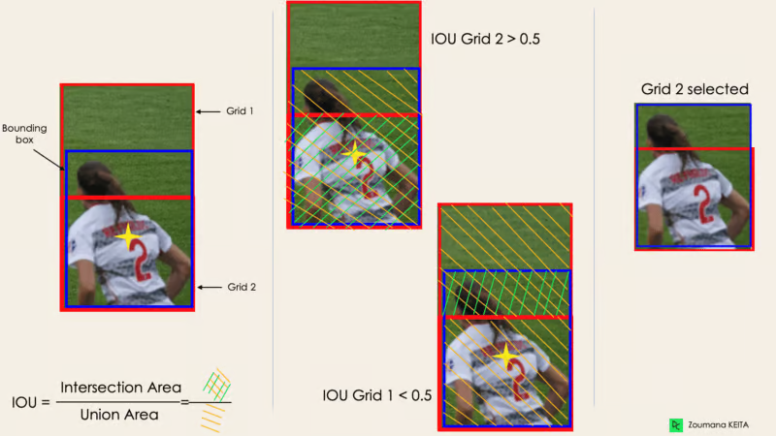
3. Intersection Over Union (IOU)
Finding the most suitable grid in case the object is in many grids using the following formula :
IoU(B1,B2) =
Area of Intersection(B1,B2)
Area of Union(B1,B2)

Slide 13
4. Non–Max Suppression (NMS):
A post-processing step.
Used to remove duplicates and,
To keep the best bounding box per an object.

Slide 14
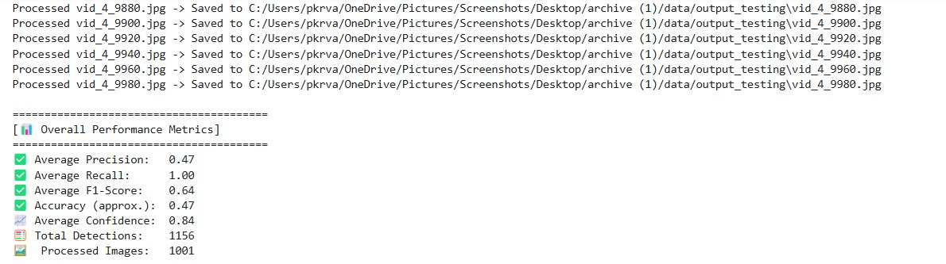
RESULTS:

Slide 15
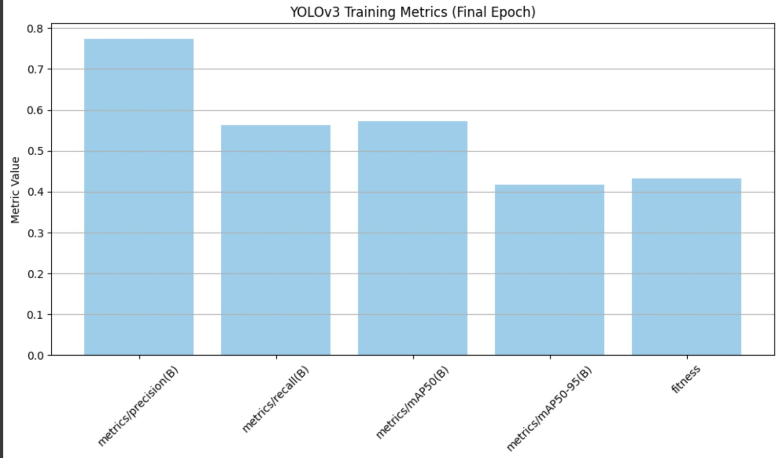

Slide 16
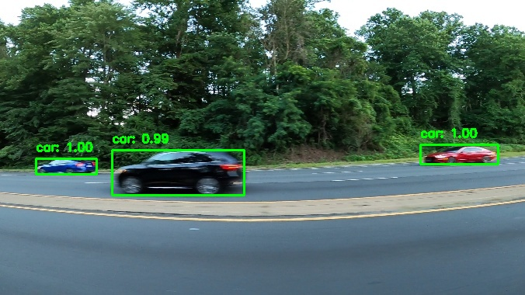
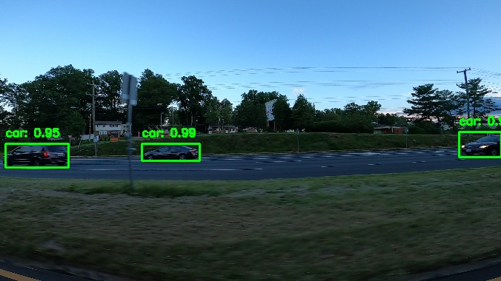
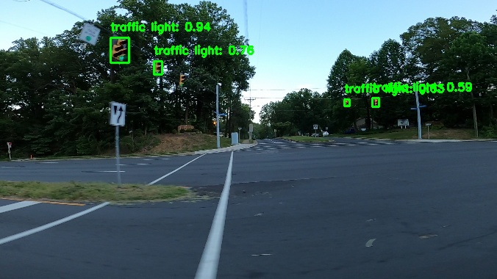
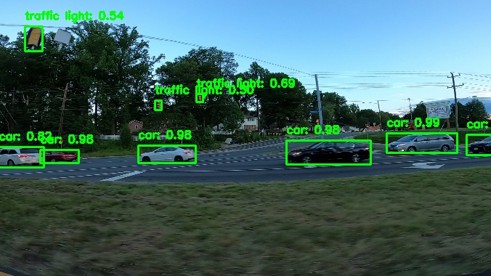

Slide 17
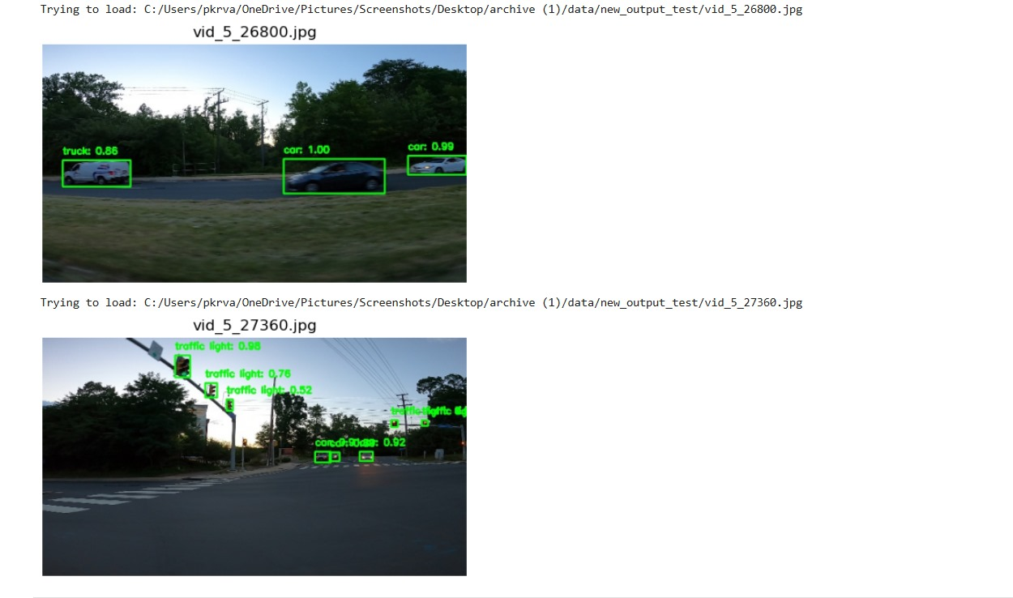

Slide 18
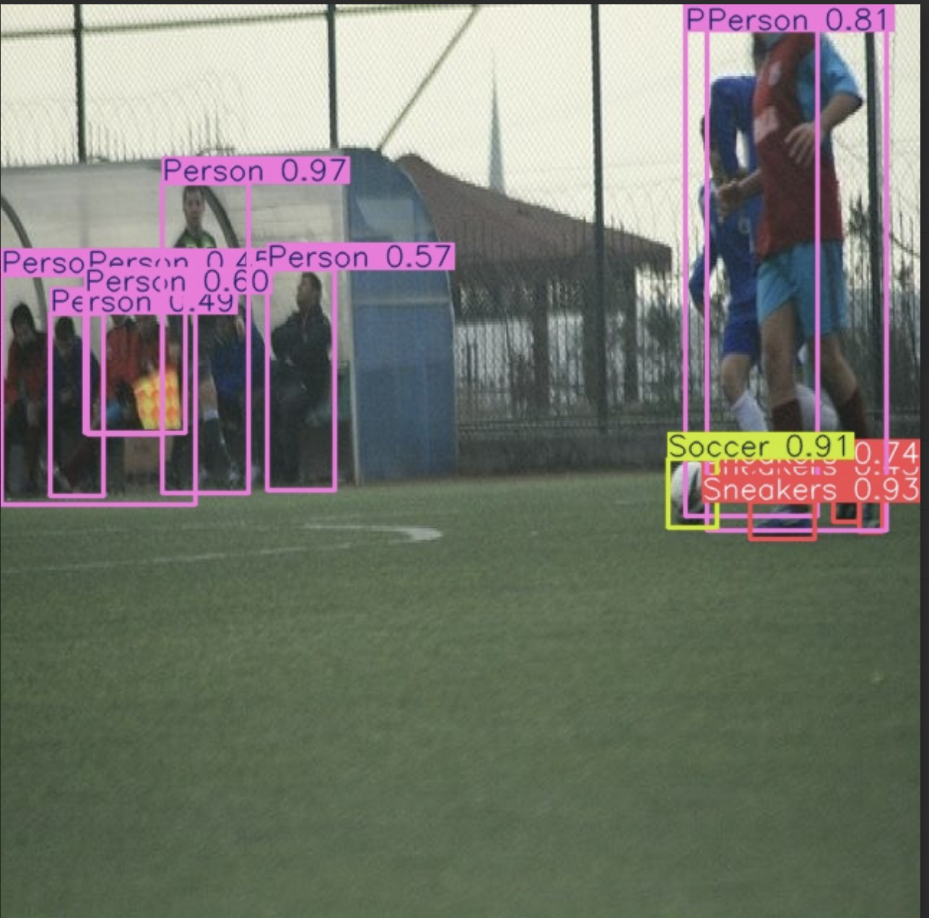
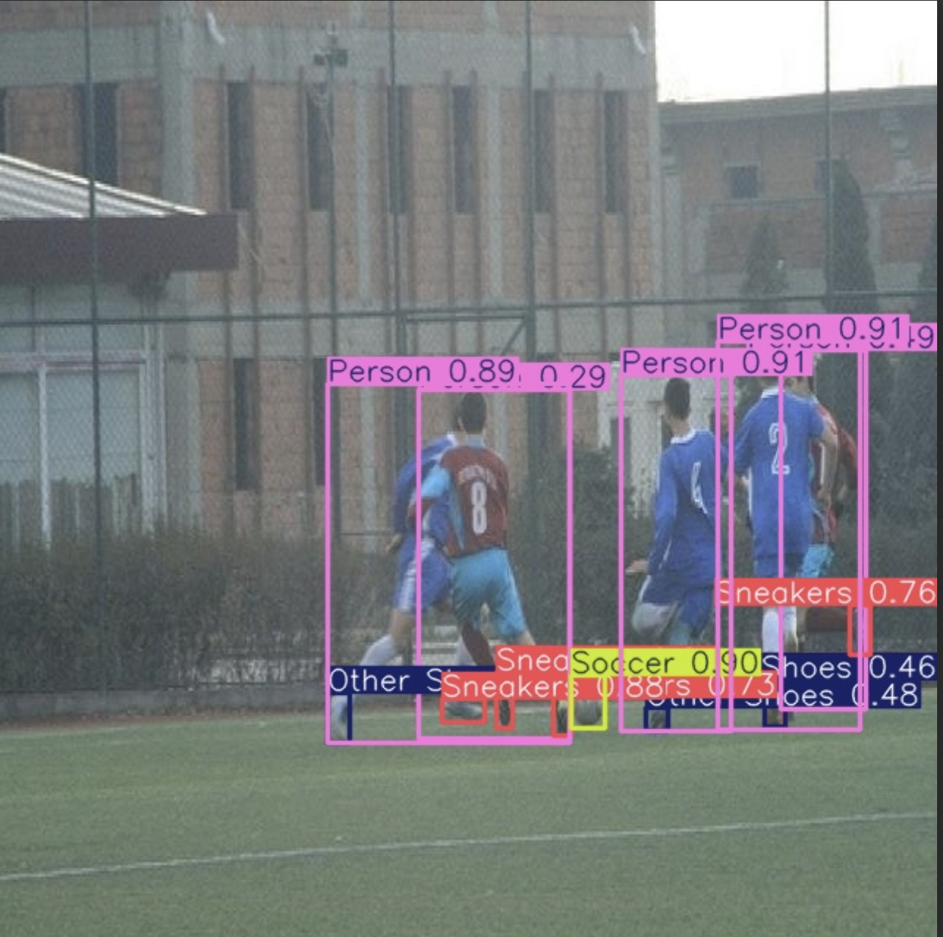
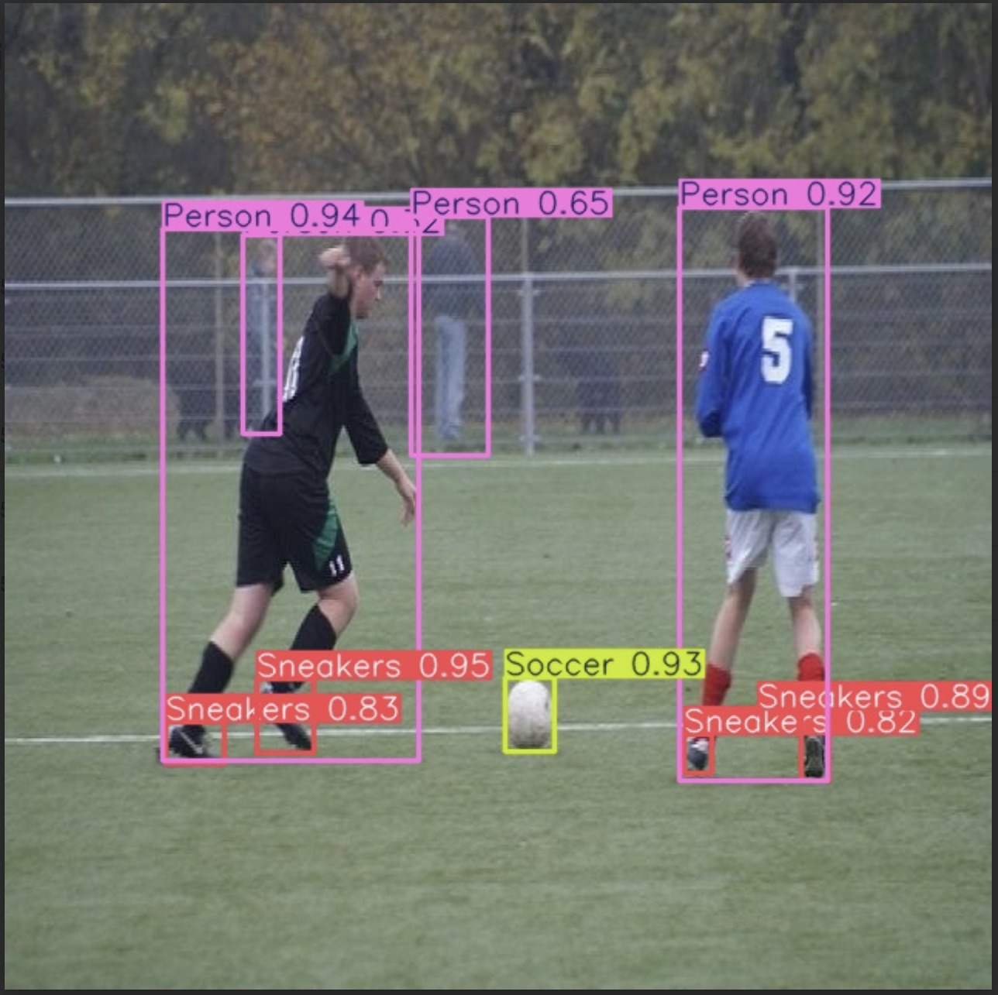

Slide 19
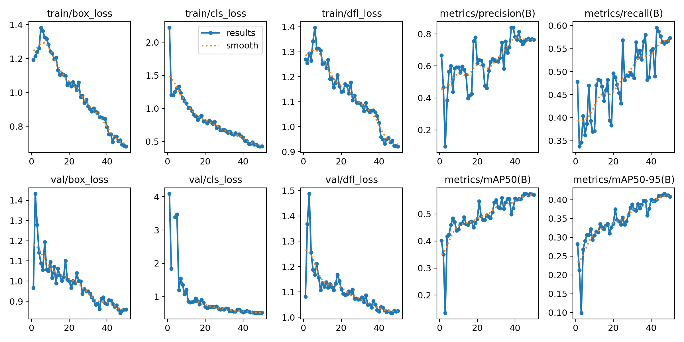

Slide 20
Conclusion
YOLO object detection has different applications in our day-to-day life.
Object detection has been introduced in many practical industries
Such as : * Healthcare
* Agriculture
* Security Surveillance
* Automatic Cars (Vehicles)

Slide 21
Future Work
Increasing the precision, accuracy levels.
Feeding more data
Integrating with any of the other object detection models.

Slide 22
Team – 18 Members :
CB.SC.U4AIE24138 – M.V. Mukesh
CB.SC.U4AIE24144 – P. Varshitha
CB.SC.U4AIE24165 – U.V.K. Sudeepthi

Slide 23
Thank You

